Slide 1

RFID & Servo Motor Control system for Automatic Door Lock

Slide 2
COMPONENTS NEEDED
Arduino UNO
LED
Breadboard
Wires
Battery
USB-A to B
RFID Module (RC522)

Slide 3
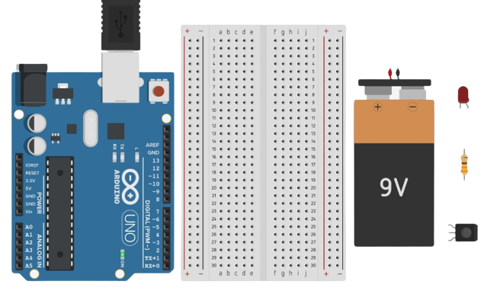
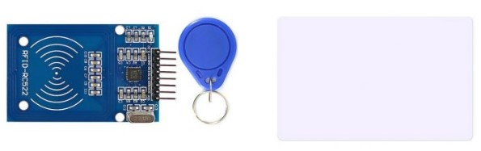
Introduction to the Components
RFID Module
Arduino UNO R3
Breadboard
Battery

Slide 4
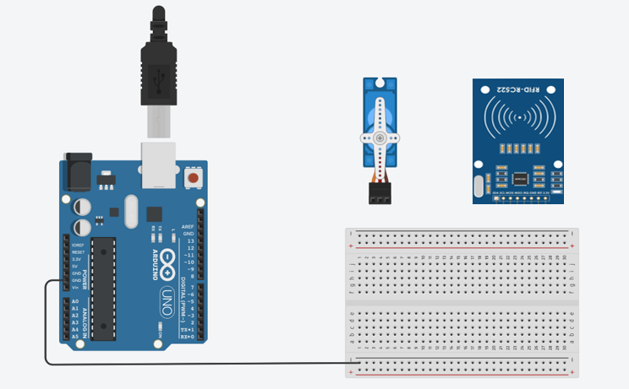
Connect Arduino GND to Breadboard negative rail

Slide 5

Connect Arduino 5V to Breadboard positive rail

Slide 6
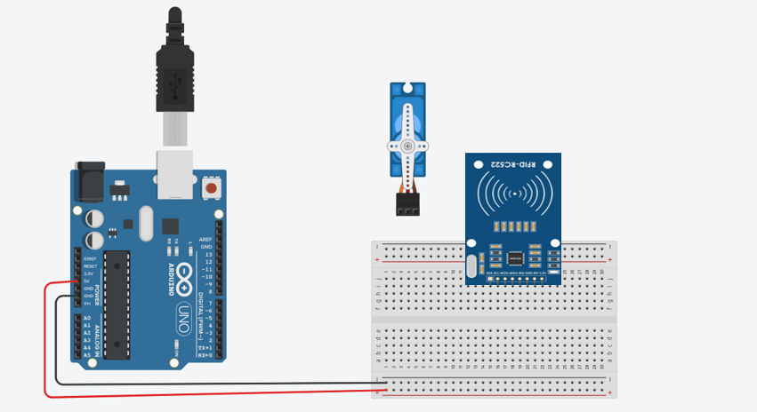
Place RFID Module anywhere in the Bread Board

Slide 7

Connect RFID VCC to 5V of Arduino

Slide 8
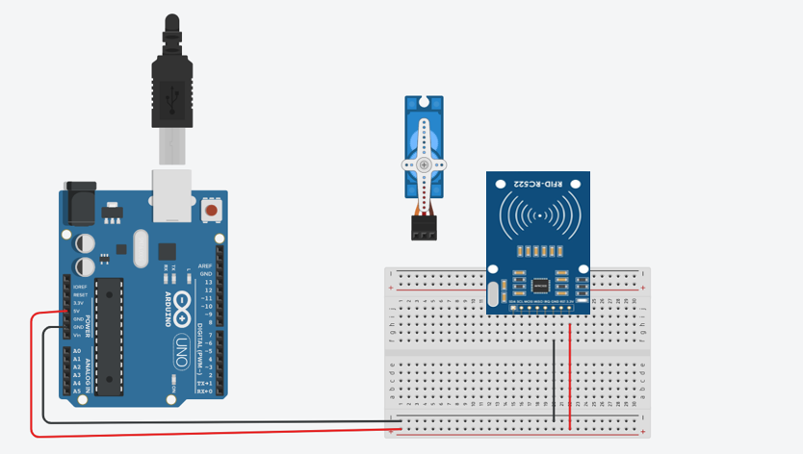
Connect RFID GND to GND of Arduino GND

Slide 9

Connect Lower BreadBoard Negative Rail to Upper Negative Rail of BreadBoard

Slide 10
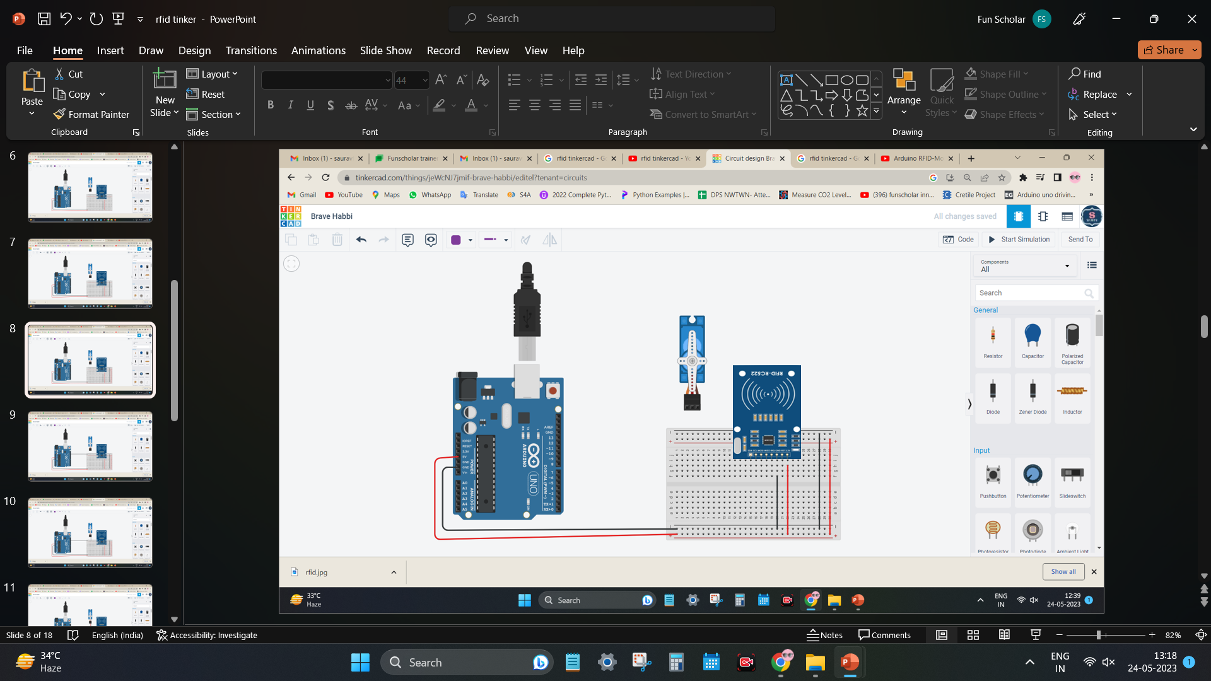
Connect Lower BreadBoard Positive Rail to Upper Positive Rail of BreadBoard

Slide 11

Connect Arduino GND to Negative rail of Breadboard

Slide 12

Connect Servo GND to Negative rail of Breadboard

Slide 13

Connect Servo Positive to Positive rail of Breadboard

Slide 14

Connect Servo Signal Pin to Arduino Pin 3

Slide 15
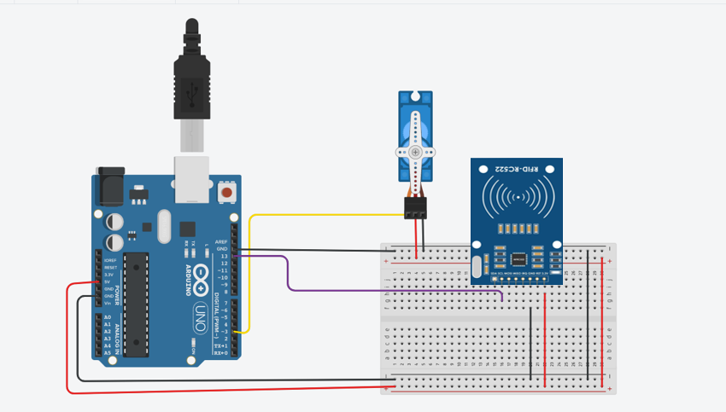
Connect RFID SCK pin to Arduino pin 13

Slide 16

Connect RFID SDA pin to Arduino pin 10

Slide 17
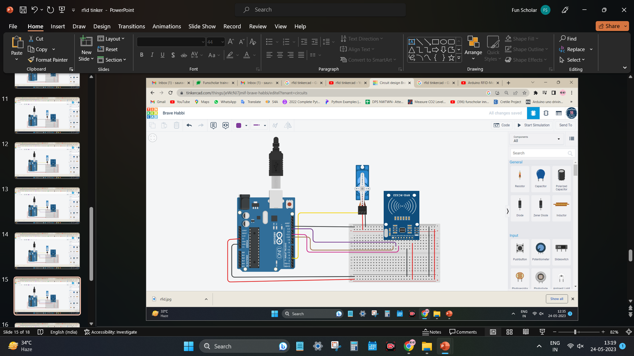
Connect RFID MOSI pin to Arduino pin 11

Slide 18
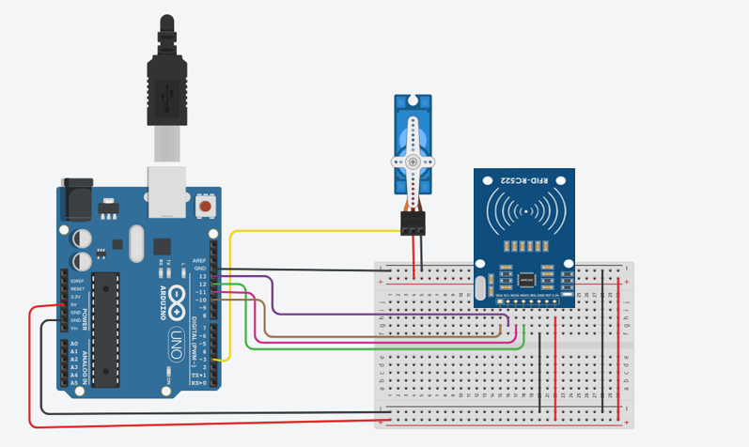
Connect RFID MISQ pin to Arduino pin 12
Do Not Connect IRQ pin to anywhere.

Slide 19
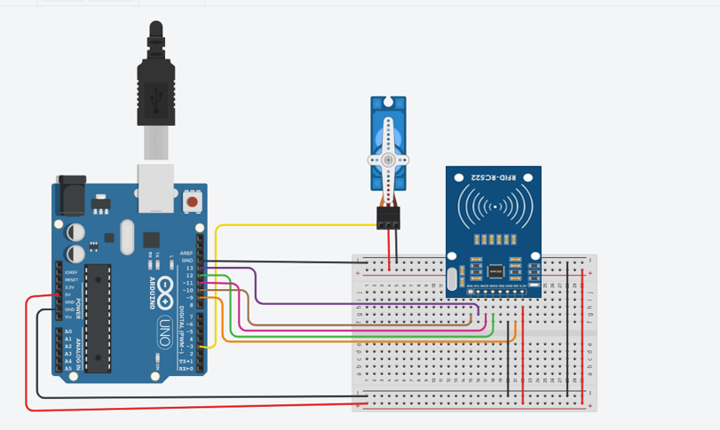
Connect RFID RST pin to Arduino pin 9

Slide 20
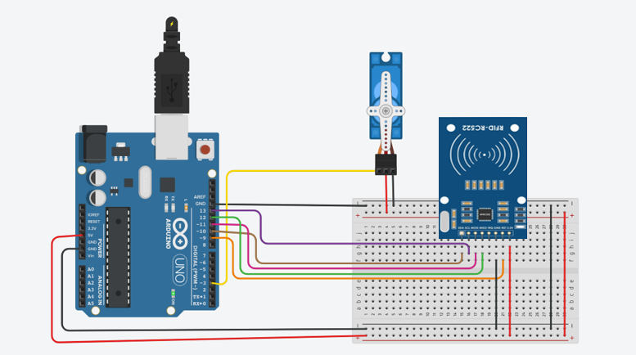
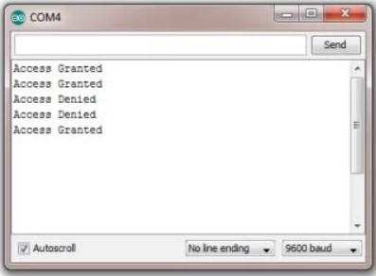
Actual image of Circuit connection & Serial monitor

Slide 21
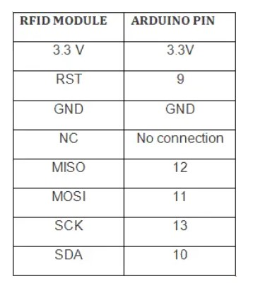
Complete Pin Connections
IRQ
13

Slide 22
Code for Arduino IDE
#include <SPI.h>
#include <MFRC522.h>
#include <Servo.h>
#define SS_PIN 10
#define RST_PIN 9
#define LED_G 5 //define green LED pin
#define LED_R 4 //define red LED
#define BUZZER 2 //buzzer pin
MFRC522 mfrc522(SS_PIN, RST_PIN); // Create MFRC522 instance.
Servo myServo; //define servo name
void setup()
{
Serial.begin(9600); // Initiate a serial communication
SPI.begin(); // Initiate SPI bus
mfrc522.PCD_Init(); // Initiate MFRC522
myServo.attach(3); //servo pin
myServo.write(0); //servo start position
pinMode(LED_G, OUTPUT);
pinMode(LED_R, OUTPUT);
pinMode(BUZZER, OUTPUT);
noTone(BUZZER);
Serial.println("Put your card to the reader...");
Serial.println();
}
void loop()
{
// Look for new cards
if ( ! mfrc522.PICC_IsNewCardPresent())
{
return;
} // Select one of the cards

Slide 23
if ( ! mfrc522.PICC_ReadCardSerial())
{
return;
}
//Show UID on serial monitor
Serial.print("UID tag :");
String content= "";
byte letter;
for (byte i = 0; i < mfrc522.uid.size; i++)
{
Serial.print(mfrc522.uid.uidByte[i] < 0x10 ? " 0" : " ");
Serial.print(mfrc522.uid.uidByte[i], HEX);
content.concat(String(mfrc522.uid.uidByte[i] < 0x10 ? " 0" : " "));
content.concat(String(mfrc522.uid.uidByte[i], HEX));
}
Serial.println();
Serial.print("Message : ");
content.toUpperCase();
if (content.substring(1) == "73 A4 A2 2E"||content.substring(1)=="F3 3A 67 97")
{
Serial.println("Access Granted");
Serial.println();
delay(500);
digitalWrite(LED_G, HIGH);
tone(BUZZER, 500);
delay(300);
noTone(BUZZER);
myServo.write(180);
delay(3000);
myServo.write(0);
digitalWrite(LED_G, LOW);
}

Slide 24
else {
Serial.println(" Access denied");
digitalWrite(LED_R, HIGH);
tone(BUZZER, 300);
delay(1000);
digitalWrite(LED_R, LOW);
noTone(BUZZER);
}
}

